Slide 2


Pre-employment Psychological Evaluation
Relevant issues for Public Safety Background Investigators

Slide 3
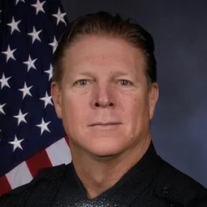

Richard Zumwalt Ph.D.
Police Psychologist Neuropsychologist
CA License #31703
rick@premier1stresponder.com
Work (805) 552-6339
Cell (714) 514-4742
Notes:
Ph.D. in 2016, Licensed since 2020. Therapy for first responders with Premier First Responder Psychological Services, POST Psychological Evaluator for Pre-employment evaluation and fitness for duty. Neuropsychological evaluations, workers compensation evaluations. Retired in 2018 after working 18 years with Huntington Beach Police Department: Beach Liaison, Detention Officer, Patrol (16 years), Arrest and Control Instructor, Patrol Rifle Team, Special Enforcement Team, Peer Support Team. Arizona State Sundevils Rose Bowl Champions 1987. Three years in professional football with the Los Angeles Raiders, Atlanta Falcons and the WLAF Sacramento Surge. 4 years on the Orange County Lawman Football team.

Slide 4

Objectives
Increase knowledge about pre-employment psychological evaluations for public safety
Differentiate between psychological suitable and unsuitable
Understand the unique challenges associated with pre-employment psychological evaluations
Apply knowledge of pre-employment psychological evaluations to candidate selections/disqualifications

Slide 5
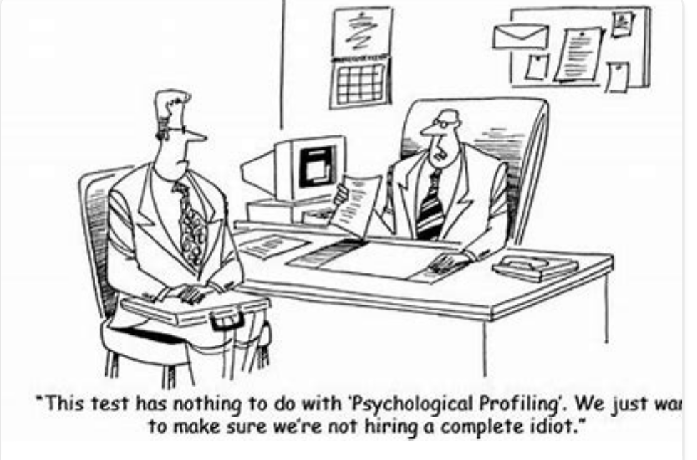

Slide 6

History of Psychological Assessment for Public Safety
Public Safety; Not so safe
Public Safety Liability
Public Trust
Notes:
Regarding public safety. I will be referring to law enforcement and firefighters. Law enforcement covers probation, dispatch, corrections, police. Firefighter covers EMT, Paramedics and firefighters.

Slide 7
Public Safety Not So Safe
Early 1900’s
California 2009-2019 Law Enforcement Convictions
Firefighters
Notes:
According to the literature and some data bases which I don’t tend to pay much attention to after seeing how studies and data bases can be biased. So a lot of the information presented in this presentation is to help facilitate discussion and curiosity of issues that seem prevalent in public safety and society today. 1. American law enforcement at the turn of the century, early 1900’s many American law enforcement officers were outlaws in the initial stage of their careers. 2. In California it was reported that in 2009-2019 630 officers were convicted of a crime in the last decade — an average of more than one a week in California. While that is only .8% of total law enforcement officers the cost adds up. 3. A total of 1,051 firefighter cases were in the database at the time of analysis, broken down into three categories: administrative, criminal and civil.

Slide 8
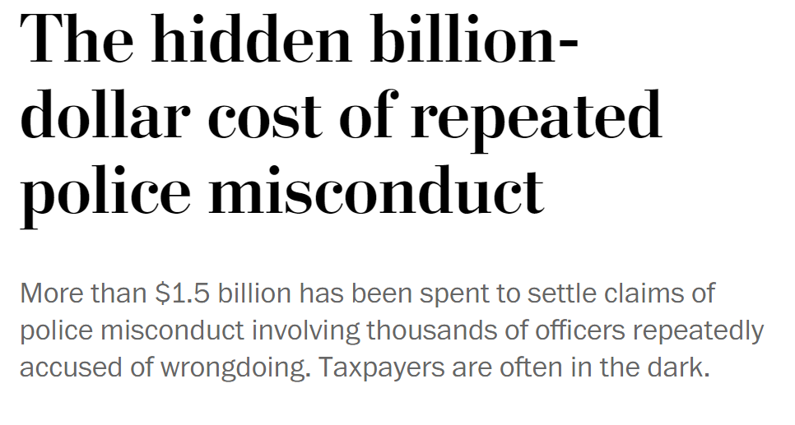
Public Safety Liability
In 2018-19, one agency alone paid out over $20 million to plaintiffs as a result of negligent lawsuits, with individual settlements ranging from $2.5 million to $4.6 million (County of Los Angeles, 2020).
Notes:
While there are sparse statistics related to the cost for firefighters and other law enforcement services. There is ample information indicating liability related to these services. Not to mention the lives of public safety personnel and citizens caught up in the liability.

Slide 9

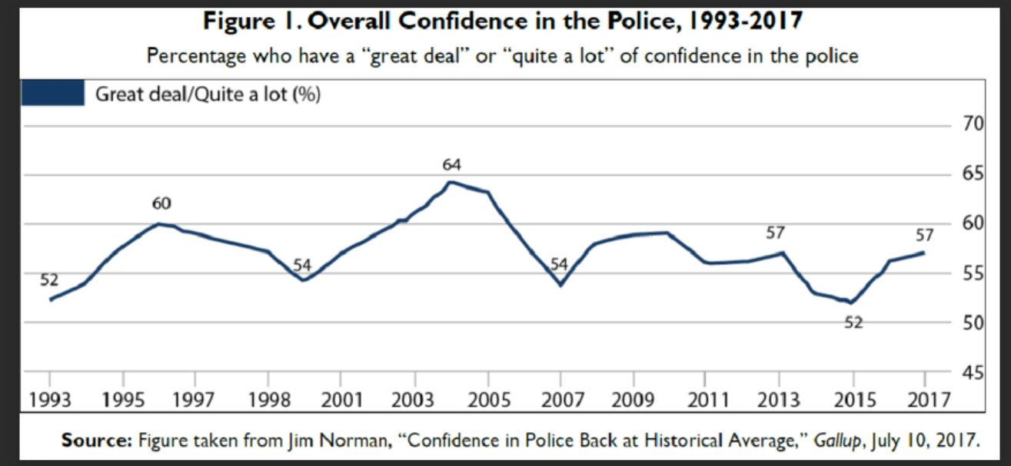
Public Trust
Notes:
As we can see, historically not a lot of trust. On one hand it is refreshing to see it is not current problem or as bad as media makes it sound. It was noted that Firefighters public trust was up around 90% despite ample evidence of misconduct, loss of life and property. Now lets look at an overview of psychological evaluation.

Slide 10
Overview of Pre-employment Psychological Evaluation for Public Safety
Based on many factors related to loss of life, discrimination, liability and public trust, the screening of public safety employees has grown. Psychological Assessment is usually the last hurdle and one that is not really well understood by most candidates or public safety members.

Slide 11
Didn’t Pass; Hired Anyway
Alameda Sheriff faces fallout over deputies allegedly failing psychological evaluations - YouTube
Notes:
I want to be clear I don’t have an opinion regarding this video, I am sure there are many points to be made about this video to. I am using it to provide some current relevance and provide information for discussion. In this video we will see some issues such as: How are officers being hired if they were found unsuitable? Psychological report indicated diagnosis when that isn’t the purpose of evaluations? Appearance of lack of public trust, giving people a chance to grow into the profession that requires they carry a gun and make life and death decisions?

Slide 12
Path of Employee Screening and Psychological Evaluation
Early 1900’s IQ tests; Below 80 thought to be unsuitable
1979 New York (Bonsignore v. City of New York)
Evaluations grow to include successful employee characteristics and traits, backgrounds and medical exams.
Notes:
1979: Police officer tried to shoot and kill his wife then shot and killed himself. City was sued for knowingly allowing psychological unfit candidates become officers. This was validated by the fact more officer were killing themselves that being killed in the line of duty.

Slide 13
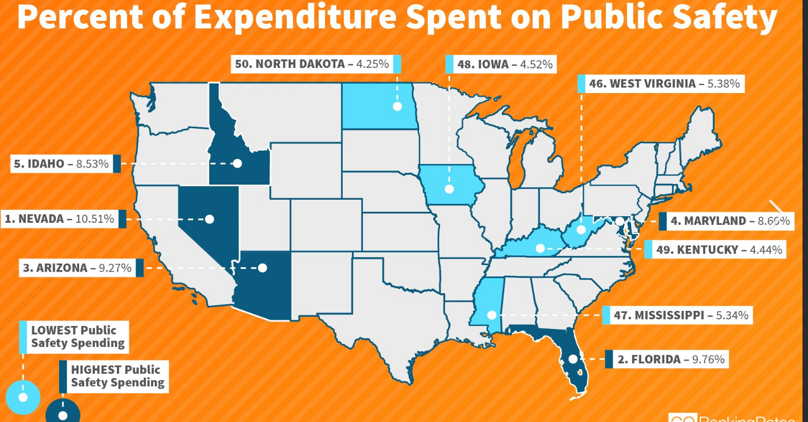
Growth of Psychological Evaluations
40 states with regulatory requirements
100,000 evaluations performed every year by as many psychologists
98% of police and sheriff’s agencies over 25,000 residents use psychological screening.
Screening makes financial sense since it cost well over $200,000 to recruit and train new candidates.

Slide 14
Not So Fast
Hero cop kicked off the force after questionable psych evaluation - Bing video
Notes:
Can we do better? We have to do better. I worked with 5 squad mates and partners who were fired for criminal activity, not to mention at least 5 others, who I didn’t work closely with. I remember the dialogue among fellow officer from other agencies and especially now as I work one on one with first responders, with dialogue about how the department doesn’t have our backs, how can always do the right thing when we are challenged at every end from citizens, economy, family, administration, peers, society.

Slide 15
Case Laws
(Section 1983; Civil Rights Act of 1871. Or 42 U.S.C 183): Recourse for government agents (city municipalities) who violate civil rights usually under the color of authority.
(Lewis v. Goodie, 1992): A police officer committed civil rights violations. Police knew and did nothing to support, investigate and evaluate, causing considerable financial loss.

Slide 16
Case Laws
(People v. Slaughter,1990): Police officer shot two citizens during a verbal dispute. The city did not appropriately screen the officer.
(Greenwood v. Dowler 1986): A police officer wields ultimate power and should not be ill-suited with questionable mental stability.
Notes:
The various cases and case law regarding law enforcement portray an attitude that as long as agencies have safeguards and accountability measures in place the chance of liability is remote. While this doesn’t guarantee successful employees and public safety, it seems to be an acceptable safeguard as society has yet to fully figure out how to govern and be governed since the beginning of humanity.
Therefore, even if we may not be able to routinely and without question predict which employee will be successful, or unsuccessful as long as we endeavor to keep the safeguards in place, stay up to date with current issues, employee characteristics and keep on the look-out for who would harm the public safety profession, themselves and/or others, we can keep trying in the interest of public safety.
Second opinions or appeals: Mandatory or not?
Can you hire a candidate who was found unsuitable?

Slide 17
POST Regulations
Are second opinion/Appeals Mandatory?
Can an agency hire a candidate who was found psychologically unsuitable?
Slido Poll
Notes:
The various cases and case law regarding law enforcement portray an attitude that as long as agencies have safeguards and accountability measures in place the chance of liability is remote. While this doesn’t guarantee successful employees and public safety, it seems to be an acceptable safeguard as society has yet to fully figure out how to govern and be governed since the beginning of humanity.
Therefore, even if we may not be able to routinely and without question predict which employee will be successful, or unsuccessful as long as we endeavor to keep the safeguards in place, stay up to date with current issues, employee characteristics and keep on the look-out for who would harm the public safety profession, themselves and/or others,
Second opinions or appeals: Mandatory or not?
Can you hire a candidate who was found unsuitable? Per POST: Hiring Authority Rights and Responsibilities. A law enforcement agency can only appoint candidates as peace ofcers who have been deemed psychologically suitable.

Slide 18
POST Regulations
An individual’s private interests in gaining employment and the public interest in assuring a fair employment process are met by allowing a disqualifed candidate to submit a secondopinion evaluation for consideration by the hiring authority [2 CCR §11071(b)(2) and Commission Regulation 1955(g)]. The hiring agency is not required to notify the disqualified candidate of this right nor pay for the second evaluation; however, should a candidate indicate that they are seeking a second opinion, the department must make available to the second opinion psychologist the peace ofcer duties, powers, demands, and working conditions and requirements that were provided to the frst-opinion psychologist.
Notes:
The various cases and case law regarding law enforcement portray an attitude that as long as agencies have safeguards and accountability measures in place the chance of liability is remote. While this doesn’t guarantee successful employees and public safety, it seems to be an acceptable safeguard as society has yet to fully figure out how to govern and be governed since the beginning of humanity.
Therefore, even if we may not be able to routinely and without question predict which employee will be successful, or unsuccessful as long as we endeavor to keep the safeguards in place, stay up to date with current issues, employee characteristics and keep on the look-out for who would harm the public safety profession, themselves and/or others,
Second opinions or appeals: Mandatory or not?
Can you hire a candidate who was found unsuitable? Per POST: Hiring Authority Rights and Responsibilities. A law enforcement agency can only appoint candidates as peace ofcers who have been deemed psychologically suitable.

Slide 19
POST Regulations
Per POST: Hiring Authority Rights and Responsibilities. A law enforcement agency can only appoint candidates as peace officers who have been deemed psychologically suitable. This applies to all public safety positions
Notes:
The various cases and case law regarding law enforcement portray an attitude that as long as agencies have safeguards and accountability measures in place the chance of liability is remote. While this doesn’t guarantee successful employees and public safety, it seems to be an acceptable safeguard as society has yet to fully figure out how to govern and be governed since the beginning of humanity.
Therefore, even if we may not be able to routinely and without question predict which employee will be successful, or unsuccessful as long as we endeavor to keep the safeguards in place, stay up to date with current issues, employee characteristics and keep on the look-out for who would harm the public safety profession, themselves and/or others,
Second opinions or appeals: Mandatory or not?
Can you hire a candidate who was found unsuitable? Per POST: Hiring Authority Rights and Responsibilities. A law enforcement agency can only appoint candidates as peace ofcers who have been deemed psychologically suitable.

Slide 20
POST Regulations: Suitability
Positive Characteristics
Negative Characteristics
Diagnosis?
Notes:
Psychologists consider personality traits, self-reported endorsements and information, observations, past/current behaviors, trauma, learning disorders, accidents (head injury), culture, medical conditions, collateral information (records, family, friends, co-workders) to make a diagnosis of mental illness. Psychological suitability is different. Rather than focusing on types of trauma, abuse, childhood diseases, disorders, medical conditions we are looking for risky characteristics.

Slide 21
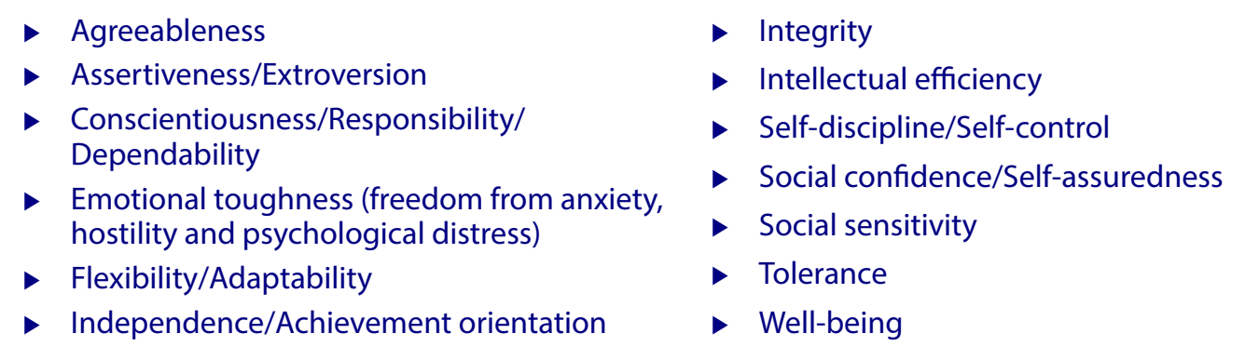
Positive Characteristics

Slide 22
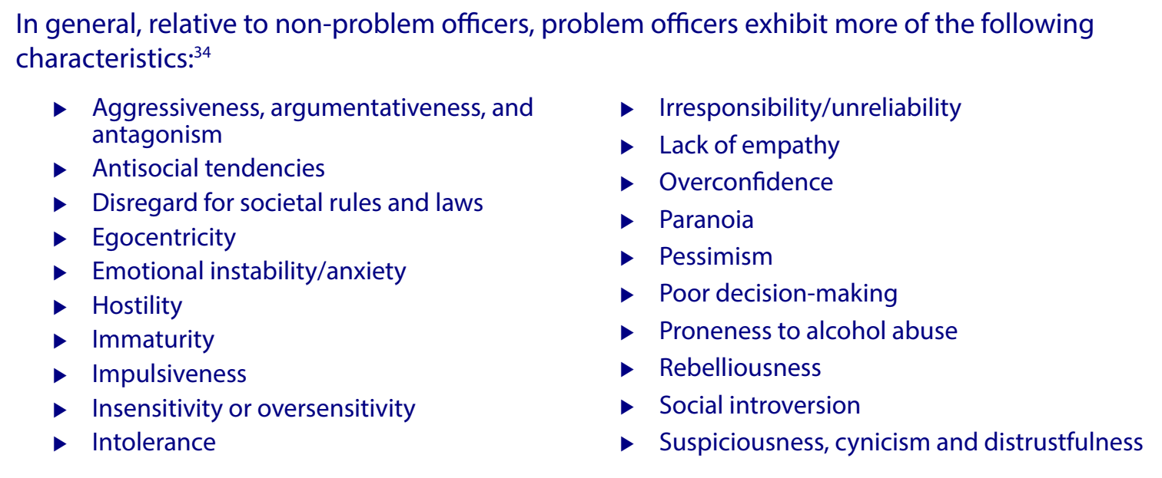
Negative Characteristics

Slide 23
Diagnosis
Diagnosis involves the combination of multiple characteristics that together manifest in specific thought patterns, moods, emotions and behaviors resulting in consequences/symptoms that meet criteria for a specific disorder.
Notes:
Psychologists do not diagnose for pre-employment evaluations

Slide 24
Psychologist’s Role
Integrate, evaluate against negative characteristics
Tolerable Risk
Difference Between Background Investigations and psychological screening dimensions
      Past vs. inferential expertise
Notes:
An agency is well within its rights to include a select-in strategy, as well as to adopt more rigorous requirements, higher standards, and/or a more in-depth evaluation beyond that required by POST [Commission Regulation 1950(d)].

Slide 25
POST Update
Bias: Implicit/Explicit (Evaluator Advisory Committee)
Condition of employment (COE) should be accompanied with the background packets.
Backgrounds need to be completed.
Notes:
Government Code §1031.3 implemented by Assembly Bill (AB) 846 (2020), required POST, by January 2022, to study, review, and update regulations and associated screening materials related to the evaluation of emotional and mental conditions required by GC §1031(f) to incorporate the identification of implicit and explicit bias towards race or ethnicity, gender, nationality, religion, disability, or sexual orientation. To that end, POST worked with a Subject Matter Expert (SME) panel, psychological evaluator advisory group and other stakeholders to formulate regulations and guidance materials to meet this requirement, including the development of the Bias Assessment Framework.

Slide 26
Screening Procedure
Interview
Backgrounds
Assessments
Notes:
An agency is well within its rights to include a select-in strategy, as well as to adopt more rigorous requirements, higher standards, and/or a more in-depth evaluation beyond that required by POST [Commission Regulation 1950(d)].

Slide 27
Challenges With Screening
Work flow where investigators don’t get a chance to review or are not allowed to review or are not aware that they can review.
May not have the time or interest even if they did
Newly hired untrained background investigators
Unclear understanding of the traits most desired by the agency.
Social demands
Supply and demand issues.
Differing opinions on what may be disqualifying information.

Slide 28
Effect of Pre-Employment Psychological Suitability
Inconsistencies and contradictions in results have led some to declare that the development of a police personality profile is fruitless (Lorr & Strack, 1994), and to question the effectiveness of pre-employment psychological testing itself (Barrett, 2003; Claussen & Arrigo, 2005).
Far from proving the invalidity of these measures, the accumulation of inconsistent and seemingly contradictory findings help to further specify characteristics and incorporate corroborating information.

Slide 29
Factors Associated With Suitability
Superman
Wonder Woman
Incredible Hulk
Joker
Real Candidate
Notes:
Superman/Wonder Woman: Impression management perfect human never did anything wrong
Incredible Hulk: Mild mannered appears docile, harmless average. Background shows tantrums, fights, law breaking
Joker: So bad you feel sorry for them and start looking for some redeeming qualities
Real Candidate: Past, Assessments, Interview all congruent. There are reasonable explanations and timelines.

Slide 30
Factors Associated With Suitability:
Case Studies
Candidate #1 Shady background (cleared per agency)
Sex in public lying and multiple agency applications over a long period of time.
Psychological Assessments were perfect.
Interview included the interviewer being educated on how people can make mistakes and learn from them with a very sincere apology for the lying, with a validation that most of the candidates friends are cops and they have sex in public. Suitable or not?
Notes:
Slido Link: Suitable or not Suitable?
Suitability factors: Collaboration with the agency to understand the background. Is sex in public with your spouse a big deal? Is lying about sex in public a disqualifier?

Slide 31
Factors Associated With Suitability:
Case Studies
Candidate #2 Criminal behavior within weeks of background investigation (stealing because of lack of finances, but didn’t get caught),
Speeding ticket and insubordination at work.
Perfect psychological assessments.
Interview included taking responsibility and made a clarifying difference between getting caught and being honest.
Notes:
Slido Link: Suitable or not Suitable?
Suitability factors: Understand background process at the agency. Is stealing and admitting it a sign of integrity? What may result in perfect assessment results?
Look up how to pass psychological evaluations. Former law enforcement personnel teaching how to pass. Helpful, but depending the instruction and level of studying can be detrimental.

Slide 32
Factors Associated With Suitability:
Case Studies
Candidate #3 Respectable background strong work ethic.
Completely bombed the psychological assessments.
Interview was honest, respectful.
Notes:
Slido Link: Suitable or not Suitable?
Suitability factors: What factors lead to endorsing critical items on the assessment, while having a clean background and no apparent red flags during the interview.

Slide 33
Factors Associated With Suitability:
Case Studies
Candidate #4 Background cleared with prior military and current PTSD.
Assessments were clear.
Interview revealed heroic actions in the military and no treatment or symptoms associated with PTSD for two years.
Notes:
Slido Link: Suitable or not Suitable?
Suitability factors: If agency is ok with PTSD, should the candidate be found suitable?

Slide 34
Critical Items That Affect Psychological Assessments
Idiosyncratic Thinking
Cultural Factors
Idiosyncratic thinking is determined by how an individual construes or interprets a statement/question, which can vary based upon culture, education, socialization, often due to differing “meaning systems”
Typically individuals will rate themselves having undesirable or desirable characteristics compared to their peers.
Latinos were found to produce higher scores than European Americans/Caucasians on PAI scales which lead to the perception of greater psychological distress and psychopathology
Asian Americans were found to produce higher scores than European Americans/Caucasians on PAI scales reflecting modesty, abasement, privacy, somatization, anxiety formal interpersonal styles, and impulse-control, which led to the perception of greater psychological distress and psychopathology
Notes:
The problem is, psychologists can formulate opinions based the clinical severity associated with idiosyncratic thinking. - At its heightened severity, idiosyncratic thinking can take the form of unique or bizarre responses, indicating the presence of a thought disorder. Research found that in a study, patients with schizophrenia had significantly higher rates of idiosyncratic thinking compared to non-schizophrenic patients
Courses on how to pass the psychological evaluation can be misleading and cause candidates to misinterpret questions and falsely report short comings or deny the wrong ones, For example: I like to get ads in the mail.

Slide 35
Police Psychologist reliance on background information
Notes:
Slido Link: Suitable Characteristics
Collaboration with agencies helps background investigators elaborate on the prevalent characteristics and point out the negative ones
Agencies preferred characteristics. Think about the agencies you work for. Which of these characteristics seem to be most preferable of current employees. Choose up to four.

Slide 36
Police Psychologist reliance on background information
Notes:
Slido Link: Suitable Characteristics
Collaboration with agencies helps background investigators elaborate on the prevalent characteristics and point out the negative ones
Agencies preferred characteristics. Think about the agencies you work for. Which of these characteristics seem to be most prevalent of current employees. Choose up to four.

Slide 37
Police Psychologist reliance on background information
A. Pathology of development (behavior problems, gifts, disability, trauma)
Notes:
Informant reports could help with statements such as: Tell me about a time that so and so did something bad. When was the last time that so and so. What is the candidate gifted at? Did they compete, win awards. What struggles did the candidate have in school? If there was family trauma. How did the candidate react to yelling in the house.

Slide 38
Police Psychologist reliance on background information
B. Pathology of traits (aggression, insubordination, instability, law breaking)
Notes:
Was the aggression instigated? How can you prove it wasn’t? How many acts of aggression? What was the nature of being fired, insubordination? Where you a leader or a follower at work? What examples can you give?

Slide 39
Police Psychologist reliance on background information
C. Diversity, Biases:
Notes:
Tell me about a time when you were racially profiled. Tell me about at time when you judged someone based on their looks or how they acted.

Slide 40
Police Psychologist reliance on background information
Red Flags
Notes:
Overly comfortable, overly formal (who are you?), or is this who you are? (not aware of the situation, afraid to be yourself? Are you hiding something?). Multiple agencies over 10 disqualified or did not continue (commitment, regulation). Lying (naïve or lying?) either way not a good sign. Have you ever done anything wrong at work? (no. Ok how many times have you left early? in the last three months?) (none, really? Oh ya well there was this one time).

Slide 41
Suicide Factors In Backgrounds Or Psych Or Service Or All Three
Law enforcement personnel are 54% more likely to die by suicide than other professions
Officers are x8 more likely to die from suicide than homicide and x3 more likely to die from suicide than accidental causes
In 2021, there were 632 law enforcement deaths in America - 25% were due to suicide (second to Covid-19)
Firefighter suicides have exceeded the rate of on-duty death by 30% for the last 6+ years
Research found that firefighters die by suicide at a higher rate than their police counterparts, as well as the public; 18 for every 100,000 in the fire service compared to 11-17 for every 100,000 within law enforcement (general population is 13 for every 100,000)

Slide 42
Service Risk Factors
Exposure to trauma (organizational, occupational, family/personal)
Department size (smaller police departments have higher suicide rates due to inadequate budget for mental health assistance; increased workload, decreased anonymity)
Alcohol use
Availability of firearms (82% of suicide attempts with firearms end in death; most officers attempting suicide opt for using their service weapon)
Strain of shiftwork
Social/public and self-perceived stigma

Slide 43
Background Risk Factors
Some California police departments (La Mesa, Barstow, Montrose) list “suicide attempts” as grounds for disqualification.
Abuse/neglect
Family violence
Loss (death, divorce, illness, incarceration, identity/purpose)
Stressful life events (unemployment, financial difficulties, loss of home)
Social instability (perceived loneliness, lack of belonging)

Slide 44
Psychological Risk Factors
Abuse/neglect
Family violence
Loss (death, divorce, illness, incarceration, identity/purpose)
Stressful life events (unemployment, financial difficulties, loss of home)
Social instability (perceived loneliness, lack of belonging)
Socially akward
Poor decision making
Depression
Anxiety
Idiosycratic thinking (extreme)
Substance abuse
Defensive avoidance

Slide 45
Military Disability vs. State Disability
40% of people who experience symptoms of PTSD recover without therapy and relapse.
VA does not require treatment
The average VA disability rating for PTSD in FY 2020 was 70%
Overall, 53.81% of veterans with a PTSD rating are either rated at 50% or 70%
As of FY 2020, 1,754,644 veterans have a PTSD rating between 0% and 100%

Slide 46
PTSD Rating:
Case Study
Candidate background cleared with a PTSD claim at 70% and medical claims that were cleared. But the PTSD claim was never cleared or treated. Multiple kills and heroic awards.
Out of the military for 6 years, solid work ethic, family life and no consequences from PTSD Claim.
Assessments normal. Solid interview: revealed that most all friends in the military also claimed PTSD. Was encouraged.
Still collecting even though completely symptom free.
Military has no qualifying timeline, treatment protocol or follow up contingencies in place at this time.
Did not pass original psych because there was no evidence of treatment or professionally documented track record of recovery. No way to determine if the candidate is recovered especially since the candidate is still receiving benefits for PTSD.

Slide 47
PTSD Ratings
0 PTSD Rating
A mental condition has been formally diagnosed, but symptoms are not severe enough either to interfere with occupational and social functioning or to require continuous medication.
10 Percent PTSD Rating
Occupational and social impairment due to mild or transient symptoms which decrease work efficiency and ability to perform occupational tasks only during periods of significant stress, or symptoms controlled by continuous medication.
30 Percent PTSD Rating
Occupational and social impairment with occasional decrease in work efficiency and intermittent periods of inability to perform occupational tasks (although generally functioning satisfactorily, with routine behavior, self-care, and conversation normal), due to such symptoms as: depressed mood, anxiety, suspiciousness, panic attacks (weekly or less often), chronic sleep impairment, mild memory loss (such as forgetting names, directions, recent events).

Slide 48
PTSD Ratings
50 Percent PTSD Rating
Occupational and social impairment with reduced reliability and productivity due to such symptoms as: flattened affect; circumstantial, circumlocutory, or stereotyped speech; panic attacks more than once a week; difficulty in understanding complex commands; impairment of short- and long-term memory (e.g., retention of only highly learned material, forgetting to complete tasks); impaired judgment; impaired abstract thinking; disturbances of motivation and mood; difficulty in establishing and maintaining effective work and social relationships.
70 Percent PTSD Rating
Occupational and social impairment, with deficiencies in most areas, such as work, school, family relations, judgment, thinking, or mood, due to such symptoms as: suicidal ideation; obsessional rituals which interfere with routine activities; speech intermittently illogical, obscure, or irrelevant; near-continuous panic or depression affecting the ability to function independently, appropriately and effectively; impaired impulse control (such as unprovoked irritability with periods of violence); spatial disorientation; neglect of personal appearance and hygiene; difficulty in adapting to stressful circumstances (including work or a worklike setting); inability to establish and maintain effective relationships.
100 Percent PTSD Rating
Total occupational and social impairment, due to such symptoms as: gross impairment in thought processes or communication; persistent delusions or hallucinations; grossly inappropriate behavior; persistent danger of hurting self or others; intermittent inability to perform activities of daily living (including maintenance of minimal personal hygiene); disorientation to time or place; memory loss for names of close relatives, own occupation, or own name.
Notes:
A common misconception from the veteran community is that you need to meet ALL the subjective symptoms tied with a certain PTSD rating in order to get that rating according to 38 CFR PTSD.
This is not true!
The Rating Veteran Service Representative, also known as the RVSR, will consider all the evidence of record, and normally will assign the VA rating for PTSD that includes the “preponderance of the symptoms.”
For example, if a veteran has 4 of the symptoms from the 70 rating for PTSD criteria and 6 of the symptoms from the 100 PTSD VA rating criteria, the RVSR shall assign the higher rating, unless evidence of record contradicts this subjective assessment.
However, the opposite is also true.
For example, if a veteran has 6 of the symptoms from the 70 rating for PTSD criteria and 4 of the symptoms from the 100 PTSD VA rating criteria, the RVSR shall assign the lower rating, unless evidence of record contradicts this subjective assessment.

Slide 49
PTSD Ratings
It is important to understand that not every veteran returning home from military service has PTSD. Some studies suggest that it affects between 10% and 20% of veterans returning from active duty.
A recent study conducted by the Naval Center for Combat and Operational Stress Control examined law enforcement agencies' hiring practices regarding PTSD. The study found that a PTSD diagnosis is not necessarily a disqualifier for a police job. Most agencies studied reported that every candidate is evaluated on a case-by-case basis and it depends on the severity of the diagnosis whether PTSD is a disqualifier. The good news for discharged veterans seeking a police career is that they should not expect to be disqualified for PTSD unless it continues to be a disabling condition.

Slide 50
Pornography
Shocking number of people watching porn at work
Shocking number 10-12 year olds watching porn
Anime (Cartoon porn) is widely popular with Gen Z.
Is Anime child porn?
  The U.S. Supreme Court recently struck down a 6-year-old law that prohibits the distribution and possession of virtual child pornography that appears to -- but does not -- depict real children.

Slide 51
Pornography
Questions about a candidate’s sexual behavior that deal with unlawful or inappropriate acts (such as using prostitutes, voyeurism, sexual assault, self-exposure, sexual harassment, selling sexual favors, viewing child pornography, or making jokes or comments in the workplace about the opposite sex or another ethnic group) are important to explore, as these constitute some of the most common reasons for officer termination (far more frequent than excessive force). However, inquiries regarding normal range, legal and consensual sexual behavior must be justified by a strong rationale.

Slide 52
Pornography
https://rewardfoundation.org/wp-content/uploads/2017/09/The-great-porn-experiment-_-Gary-Wilson-_-TEDxGlasgow.mp4
Depression, job burn out, addiction, anxiety, poor interpersonal skills, erectile dysfunction, irritability, ADHD, memory loss, calling in sick, accidents, mistakes, etc. all related to porn.
There is no general consensus in the area of psychological suitability regarding extent of porn that is considered normal
One method is to treat porn similar to marijuana and alcohol.

Slide 53
Social Media
Type, time, activity
Look for traits, characteristics of bullying, being bullied, isolation, socially awkard.

Slide 54
Final Thoughts
Can looking through the lens of psychological evaluator help background investigation?
Can lack of collaboration affect candidate suitability?
What social and agency factors can affect suitability?
    Social pressures
    Lack of qualified candidates
    Competition with other agencies
    Poor morale
    Stay the course: Screening can be challenging but is very necessary, if anything to provide society with assurance that everything possible is being done to ensure their Public Safety.

