Slide 1
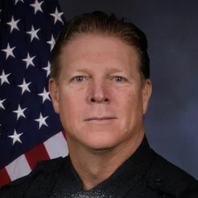

Richard Zumwalt Ph.D.
Police Psychologist Neuropsychologist
CA License #31703
rick@premier1stresponder.com
Work (805) 552-6339
Cell (714) 514-4742
Notes:
Ph.D. in 2016, Licensed since 2020. Therapy for first responders with Premier First Responder Psychological Services, POST Psychological Evaluator for Pre-employment evaluation and fitness for duty. Neuropsychological evaluations, workers compensation evaluations. Retired in 2018 after working 18 years with Huntington Beach Police Department: Beach Liaison, Detention Officer, Patrol (16 years), Arrest and Control Instructor, Patrol Rifle Team, Special Enforcement Team, Peer Support Team. Arizona State Sundevils Rose Bowl Champions 1987. Three years in professional football with the Los Angeles Raiders, Atlanta Falcons and the WLAF Sacramento Surge. 4 years on the Orange County Lawman Football team.
Grateful and honored to be here. Grinding away as a neuropsychologist and police psychologist. I am honored to be here thanks to Victoria and Mitch
In my experience as a police officer and psychologist I have had some unique opportunities to apply the things I will be talking about and it so it is very important for me to make everything relevant and easy to understand.
I hope that if anything I am able to provide an experience that enables you to enhance your job, inspire you to keep doing what you do and motivate to you stay the course as we are vital to the field of public safety.
I will be referring to public safety, law enforcement and fire department. Law enforcement includes probation, corrections, police, sheriff’s, dispatch and fire includes EMT, Paramedics. Anybody from police backgrounds? Corrections? Probation? Fire? Police? Sheriffs? Did I miss anyone? Now would like to introduce SLIDO. Please take your phones and go to slido.com and enter log in and password or take a picture of the QR code. I like to encourage some collaboration and draw on years of experience to help bring things home.
Now go to your first Poll. How about experience. Five or less years on? 6-10 years? 11-15? 16-20? 21-25? 26-30? 31-35? 36-40? 40 plus years.
Got about 3 hours of training, couple breaks and lunch then I will be back for the afternoon session.

Slide 2

Law Enforcement Training Solutions (LETS), LLC
POST Presenter
STC Presenter
Professional Development
Notes:
LETS was created in 2015 by Mitch Sigal and Art Baron, both POST Master Instructors
LETS has conducted law enforcement training throughout the entire State of California and various other States
Recently Presented Procedural Justice – Implicit Bias to the National Institute of Health, Division of Police
Instructors comprised of current and retired law enforcement from the patrol, investigative, and corrections side of the house; mental health professionals, lawyers, and college professors.
Currently working on Vicarious Trauma class and the redesigned Background Investigator course which will include all of the SB-2 information and Social Media Searches

Slide 3

Premier First Responder Psychological Services
Who We Serve
What We Offer
Police
Fire
Dispatch
Emergency Medical Services
Corrections
Emergency Room Personnel
Criminal Justice Professionals
Retirees
Significant Others
Psychological & Consultation
Crisis Response
Peer Support Development
Training
Pre-Employment Evaluation
Fitness for duty
Neuropsychological Evaluations
Peer Support Groups
Notes:
Premier First Responder Psychological Services
Premier First Responder Psychological Services (premier1stresponder.com)

Slide 4

Objectives
Increase knowledge about generational characteristics.
Differentiate between generational characteristics.
Understand the unique challenges of hiring Gen Z
Apply knowledge of Generation Z strengths, weaknesses to enhance appropriate selection of public safety candidates.

Slide 5
Pre-Test
Add Slido QR code and address
https://app.sli.do/event/d8UMevQepsqosxRC5ykg1P
Notes:
If you have access to Slido please go to the pre-test and answer the questions. Allie will go over the results and we will see what we can learn. If you don’t have Slido ability, please complete the pre-test in your handout.

Slide 6
“Our youth now love luxury. They have bad manners, contempt for authority; they show disrespect for their elders and love chatter in place of exercise; they no longer rise when elders enter the room; they contradict their parents, chatter before company; gobble up their food and tyrannize their teachers”
(Sacrotes 470-399 BC)

Slide 7

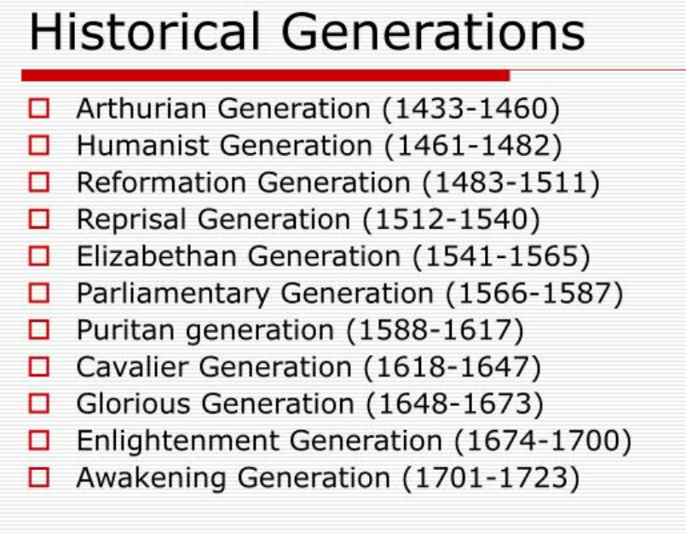
History of Generations

Slide 8
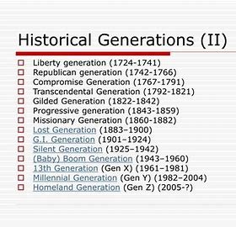
History of Generations

Slide 9

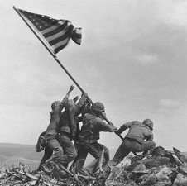
GI Generation
1901-1925
They were teenagers during the Great Depression and fought in World War II. Sometimes called the greatest generation or the swing generation because of their jazz music. U.S. Marines raise the American flag atop Mount Suribachi, Iwo Jima, on Feb. 23, 1945.

Slide 10
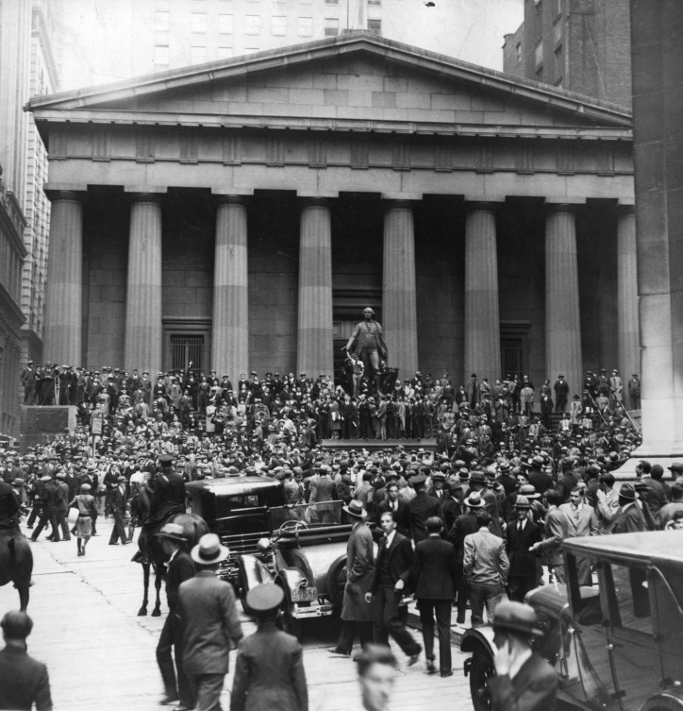

The Silent Generation 1925-1942
They were too young to see action in World War II and too old to participate in the fun of the Summer of Love.
This label describes their conformist tendencies and belief that following the rules was a sure ticket to success.
The Sub-Treasury Building (now Federal Hall National Memorial) opposite the Wall Street Stock Exchange in Manhattan, New York, at the time of the Wall Street Crash.

Slide 11
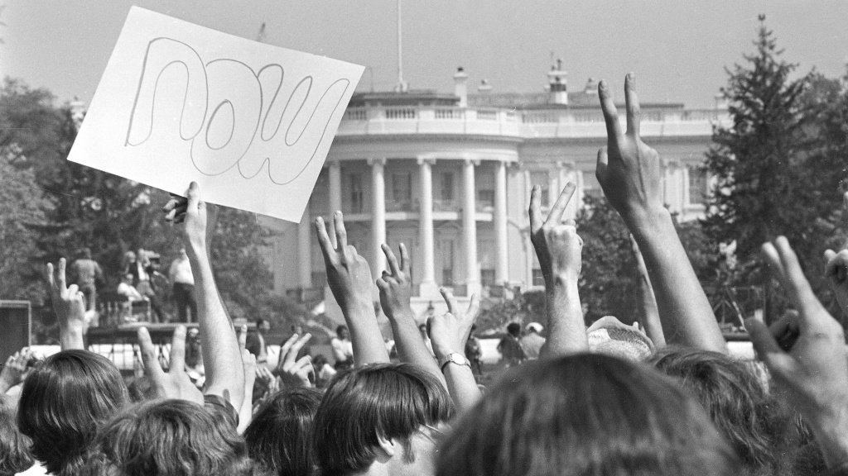

Baby Boomers 1943-1964
The boomers were born during an economic and baby boom following World War II. These hippie kids protested against the Vietnam War and participated in the civil rights movement, all with rock 'n' roll music blaring in the background. Anti-Vietnam War demonstrators hold up signs and raise their hands toward the White House in a protest. The term "baby boomers" stuck for this generation because of their tumultuous youth.

Slide 12
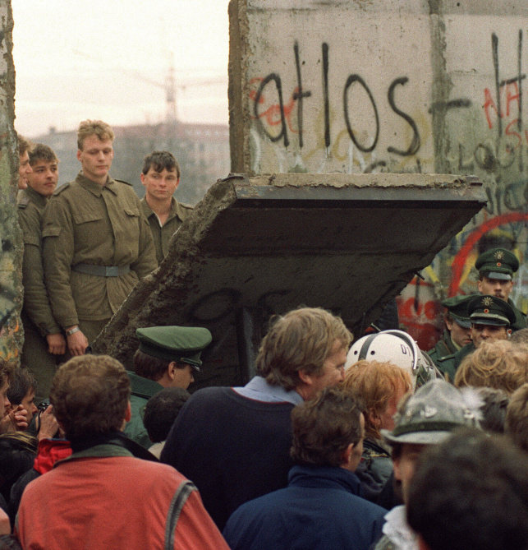
Generation X 1965-1979
They were originally called the baby busters because fertility rates fell after the boomers. As teenagers, they experienced the AIDs epidemic and the fall of the Berlin Wall. Sometimes called the MTV Generation, the "X" in their name refers to this generation's desire not to be defined. Generation X, originally called the baby busters, experienced the fall of the Berlin Wall.

Slide 13

Millennials Generation Y 1980-1996
They experienced the rise of the Internet, Sept. 11 and the wars that followed. Sometimes called Generation Y. Because of their dependence on technology, they are said to be entitled and narcissistic. Millennials love selfies and talking about themselves.

Slide 14

Generation Z 1997-2013
These kids were the first born with the Internet and are suspected to be the most individualistic and technology-dependent generation. Sometimes referred to as the iGeneration for their dependence on the internet.

Slide 15
Generation Alpha
2014-2025
The next generation will be shaped mostly by the same things as generation Z, and its not clear what new factors may play a role and to what extent or outcome on generational thoughts and behaviors. Researchers and popular media use the early to mid 2010s as starting birth years and the mid 2020s as ending birth years. First generation born entirely in the 21st century. So far characterized by failing fertility rates, electronic entertainment over physical activity, traditional TV failing, increased allergies, obesity and health problems related to screen time.

Slide 16
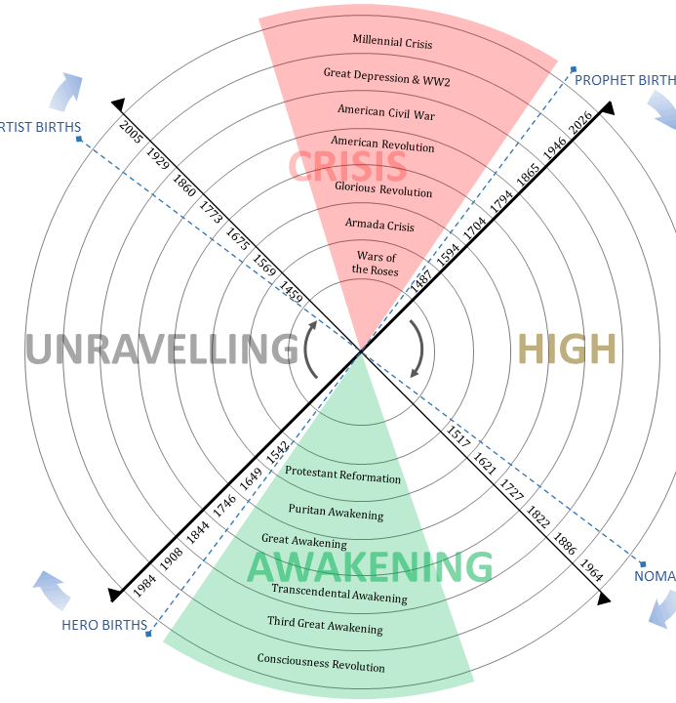
Generation Archetypes
Idealist: Born after a crisis during a time of rejuvenated community life around a new social order. Increasingly indulged, self-absorbed, young crusaders of an awakening. Focus morals, values elder leadership. Baby Boomers (1946-1964)
Reactive: Born during an awakening. A time of social ideals and spiritual agendas. Young adults passionately attack the established institutional order. Grow up as under-protected children and come of age as alienated post awakening adults. Generation X (1965-1979)
Civic: Born after an Awakening. Self-reliance and ambivalence, team-oriented optimists, energetic, overly confident, midlifers, and politically powerful elders, community, affluence and technology. Millennials (1980-2000)
Adaptive: Born during a crisis. A time when great danger cut down social and political complexity in favor of public consensus, aggressive institutions, and ethic of personal sacrifice. Socialize as conformists, process-oriented. Silent Generation (1925-1945)

Slide 17
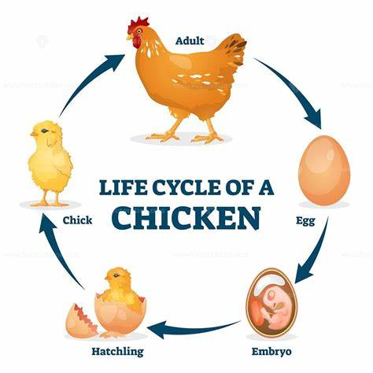

Factors That Influence Generations?
Life Cycle
When a life cycle effect is at play, differences between younger and older people are largely due to their respective positions in the life cycle. For example, young people are far less likely than older adults to vote and engage in politics. This may be because they are less informed about politics or feel they have less at stake in political or policy debates.
The Whys and Hows of Generations Research | Pew Research Center

Slide 18
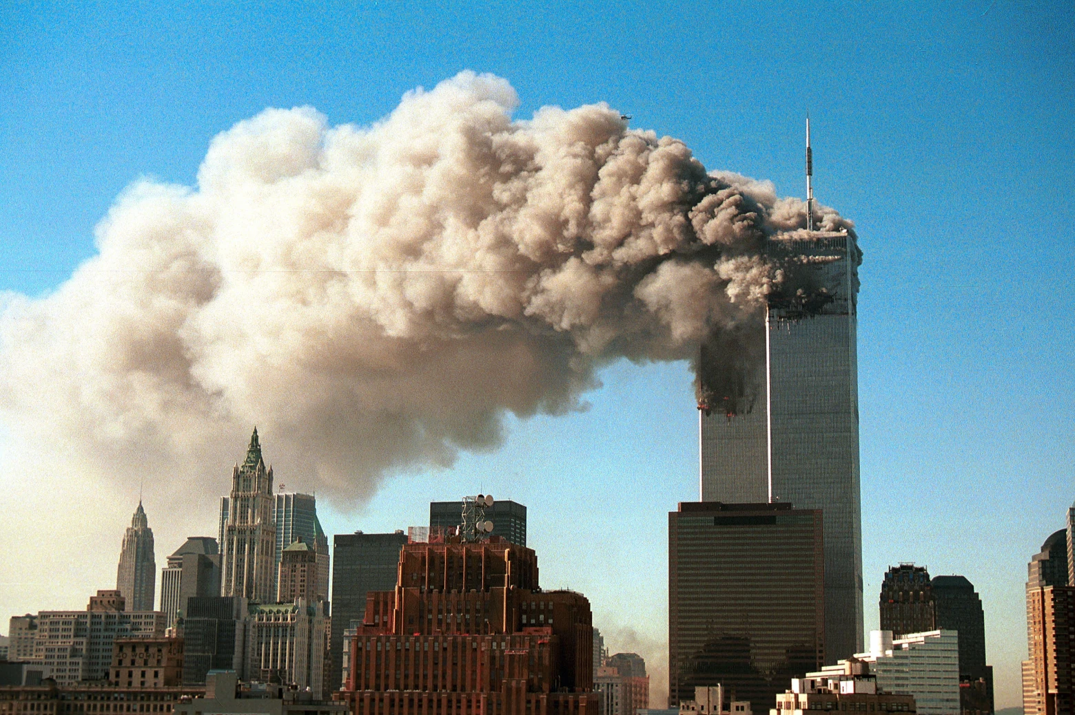
Factors That Influence Generations?
Period Effect
Period effects are seen when events and circumstances (for instance, wars, social movements, economic booms or busts, scientific or technological breakthroughs) as well as broader social forces (such as the growing visibility of gays and lesbians in society) simultaneously impact everyone, regardless of age. Period effects are typically thought to have lasting effects on an entire population.
The Whys and Hows of Generations Research | Pew Research Center

Slide 19
Factors That Influence Generations?
Period Effect
An example of a lasting period effect is the shift in public views on the issue of terrorism and the priority given to homeland defense and combatting terrorism globally following the September 11, 2001 terrorist attacks. However, other shifts in opinion following 9/11 proved to be less enduring: expressions of patriotism and unity were short-lived as the country soon entered a fractious debate over the Iraq war and deep partisan divisions on political issues soon reemerged.
The Whys and Hows of Generations Research | Pew Research Center

Slide 20
Factors That Influence Generations?
Cohort Effect
Differences between generations can be the byproduct of the unique historical circumstances that members of an age cohort experience. (e.g., the younger generations of today did not experience the Vietnam War or other social movements of the 1960s and 1970s, because they were not yet born).
The Whys and Hows of Generations Research | Pew Research Center

Slide 21
Other Factors That Influence Generations
Parenting
Technology
Economics
Media

Slide 22
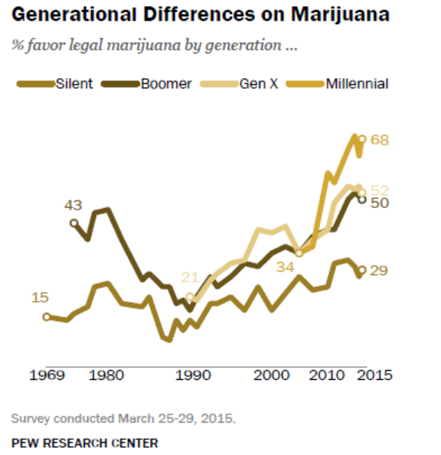
Generation Differences
Millennials (who were born in the 1980s and 1990s, are the most supportive of marijuana legalization: Since 2006, the share of Millennials favoring the legal use of marijuana has doubled, from 34% to 68%, reflecting a sharper rise in support than seen among Xers and Boomers.
Notes:
Silent 15-29% 1969-2015. Boomer 43-50% Gen X 21-52 1990-2015 Millennial 34-68%

Slide 23
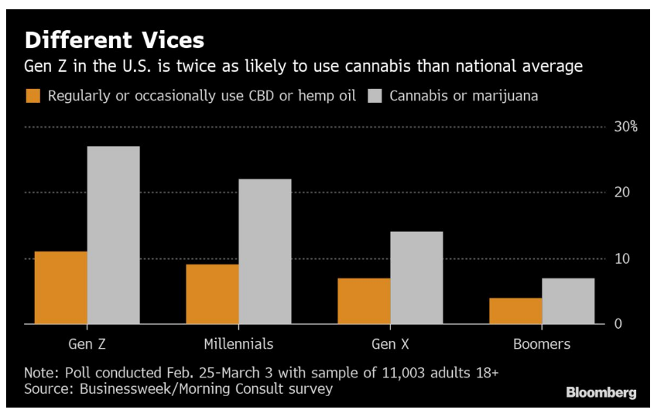
Generation Differences
Gen Z is twice as likely to use cannabis than the national average. Gen Z women are the fastest growing consumers of legal marijuana.

Slide 24
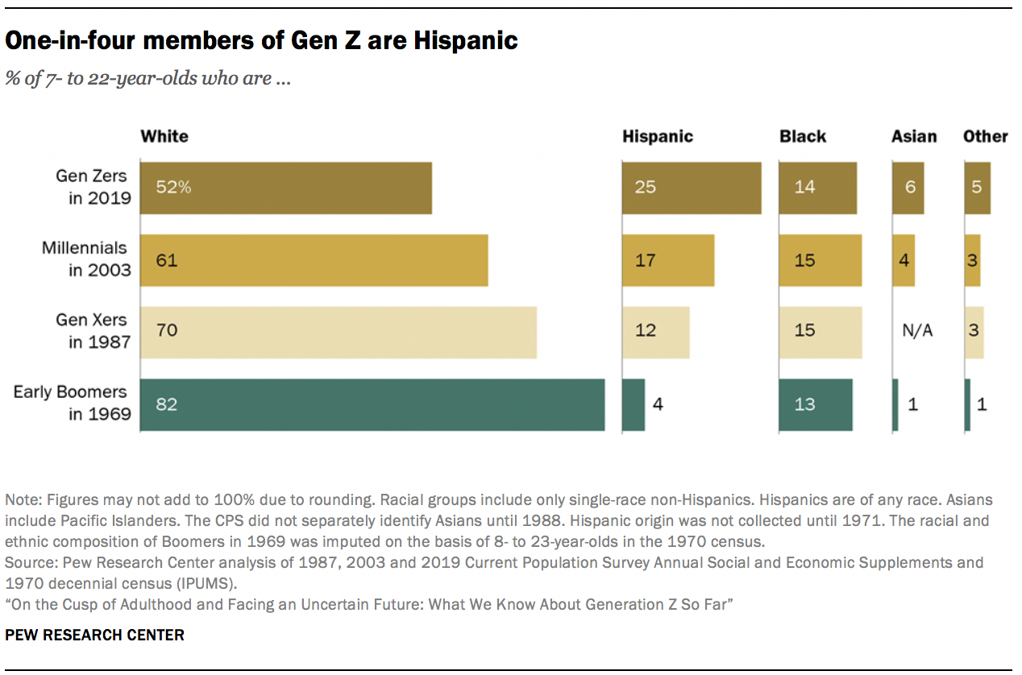
Generation Differences
Notes:
Gen Z is the most diverse generation ever in the US

Slide 25
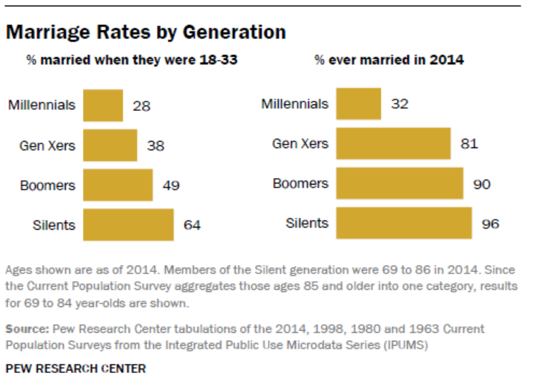
Generation Differences

Slide 26
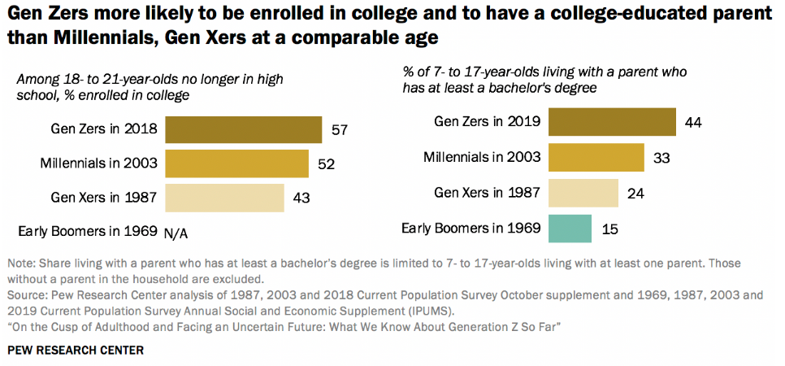
Generation Differences

Slide 27
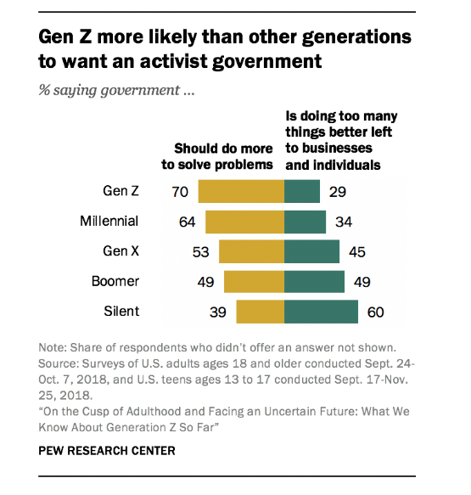
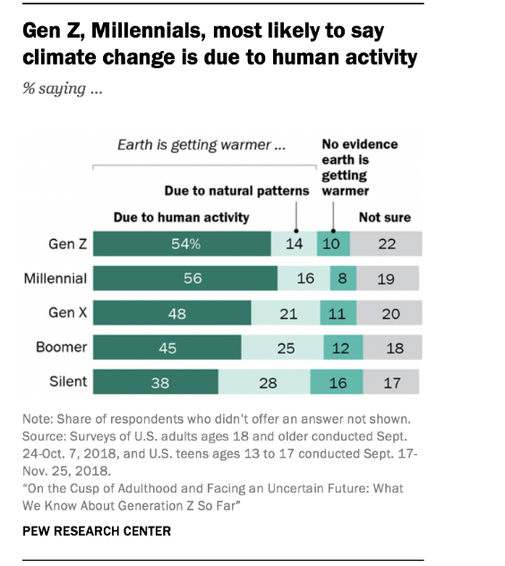
Generation Differences

Slide 28
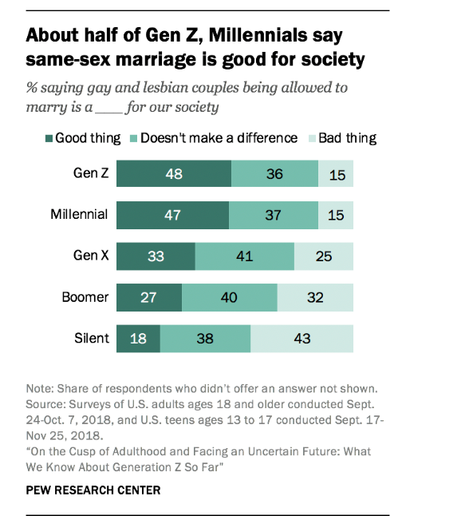
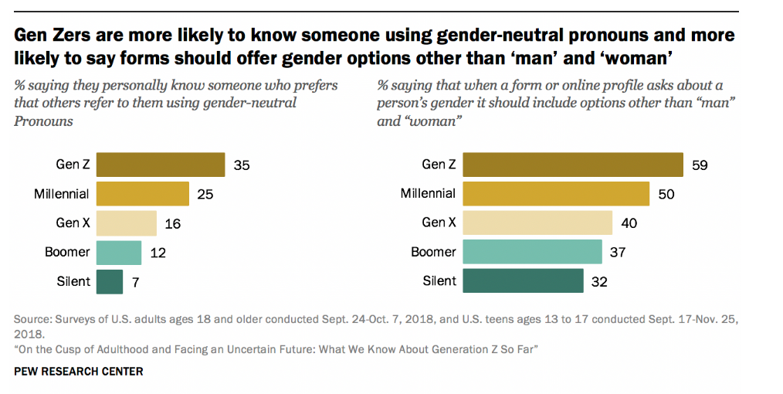
Generation Differences

Slide 29
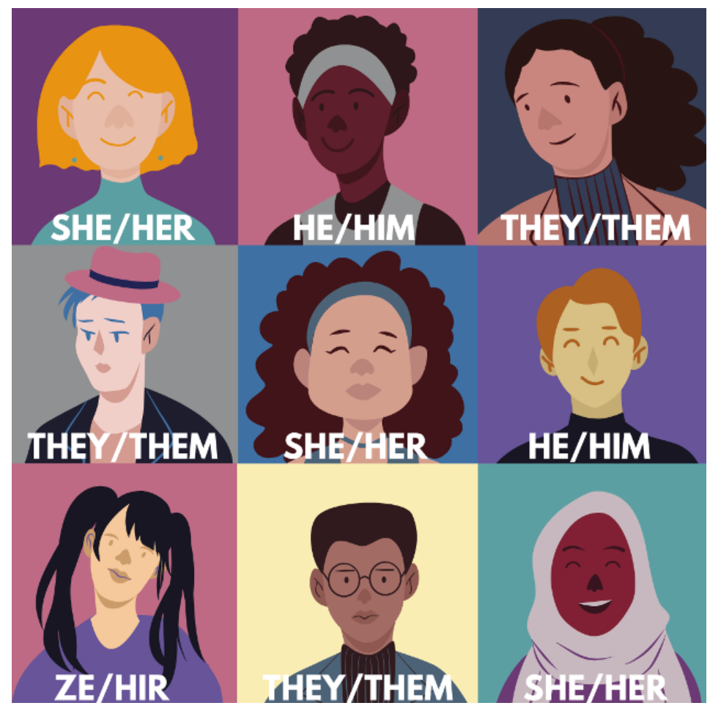
Gender Neutral Pronouns

Slide 30
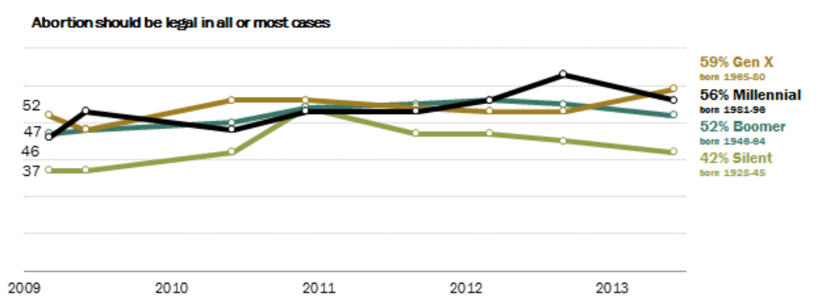
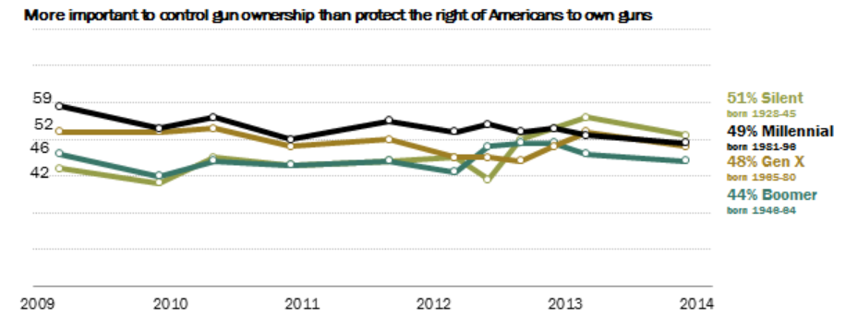
Generation Differences
Abortion: Generationally not much difference
Gun Control: Generationally not much difference

Slide 31
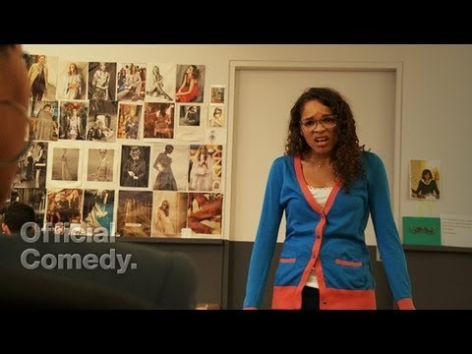
Notes:
Differences in generational characteristics can be challenging. Take a look at this video and see if you can identify any challenges.

Slide 32
Generational Differences can lead to bias in the Workforce
Personal and unreasoned judgement.
There are hundreds of different types of bias
Natural human condition that helps us quickly assess situations and people.
It can also lead to inefficiency as our world grows and boundaries widen.
Notes:
Its feasible that generational differences can lead to bias.

Slide 33
BIAS
Some examples include:
Implicit, explicit, agency, procedural, recency, confirmation, Dung-Kruger Effect, cultural, In-group, decline, optimism or pessimism, self-serving, information, availability, fundamental attribution error, hindsight, anchoring, observer.
Notes:
There are hundreds of biases identified that we are affected by both positively and negatively. One common bias in the workforce and a buzz word lately in the field of law enforcement is implicit bias.
Dung-Kruger Effect (overestimate own ability)

Slide 34

Notes:
In this video we will see how implicit bias can be everywhere and it seems that it’s related to generational differences. Towards the end they are just pointing out their personality flaws which we will also be exploring later.

Slide 35
Challenges with Generational Characteristics in the Workforce and Bias
1. Not knowing there are differences. Naive
2. Expecting all generations to be like ours. Judging.
3. Interpreting generational characteristics as personal traits.
Notes:
We have learned about differences in generations. Now lets take a look at some differences in the workforce.

Slide 36
Age of Workplace Generations
Silent Generation (Traditionalists): are the oldest, born 1928-1945. They are between 77 to 94 years old as of 2022.
Baby Boomers: are the oldest, born between the years 1946 and 1964. They are between the ages of 56-75 years old.
Gen X: Born between 1965 and 1980. They are between the ages of 40 and 56.
Generation Y (Millennials): Born between roughly 1981 and 1994. They are between the ages of 27 and 40.
Gen Z: Born between 1995 and 2009. The oldest workers are 26 years old.

Slide 37
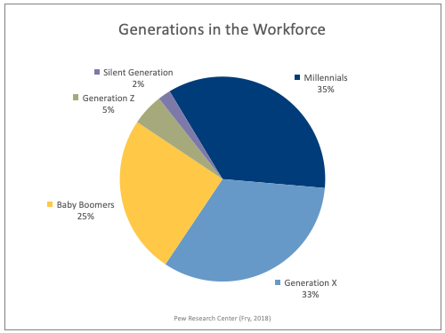
Notes:
As you can see there are 5 generations currently in the workforce. That can play a role in conflicts, productivity, job satisfaction, hiring. Aging administration from Baby Boom now in charge of hiring Gen Z can be challenging.

Slide 38
Relevant Generational Characteristics of the Workforce
Silent Generation (Traditionalists). This generation has a lot of experience to share and may act as mentors to the younger workforce.
often value loyalty and make an effort to help others.
Strong work ethic, not comfortable working non-traditional days/hours, security, serious team members, formal attitudes, loyalty, engaging, complete tasks, consistency, dependability, hard working

Slide 39
Relevant Generational Characteristics of the Workforce
Baby Boomers: Hard working, risk goals, dedicated, hierarchy, don’t need feedback, like insight in promoting, challenge status quo, innovate, inspire teams, good mentors. Known as the “Me” generation
Generation X: Independent, entrepreneurial, more relaxed, friendly, flexible, productivity vs. time spent at work, efficiency and innovation, autonomy to make own choices, healthy work-life balance, skeptical.
Generation Y (Millennials): Creative, tech savvy, result oriented, passionate about relaxed work environment, not afraid to challenge over innovation, consistent feedback. Known as the “Me, me, me” generation

Slide 40
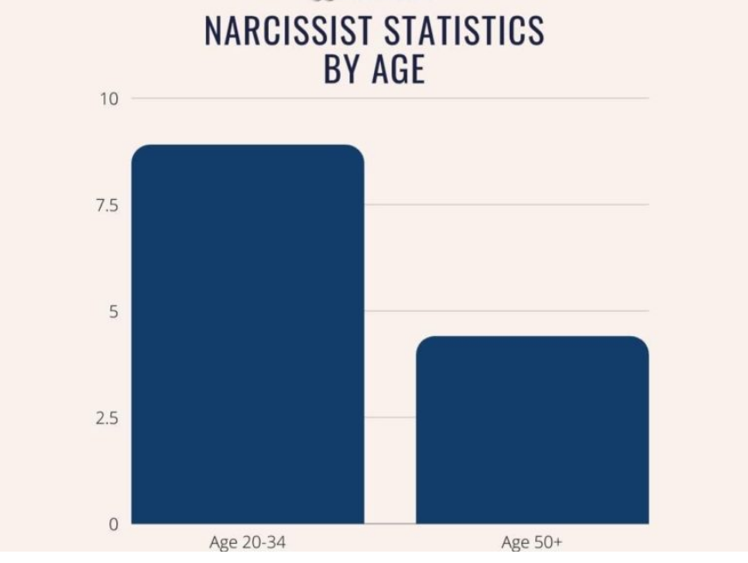
“Me, me, me, me” Generation in 2022

Slide 41
Relevant Generational Characteristics of the Workforce
Generation Z: Broad and innovative, global mindset, prioritize authenticity, truth and connectivity, adaptive to change and expect it, like flexible work hours, prefer job over employer satisfaction, diversity, social responsibility. Know as “Zoomers”

Slide 42

Notes:
This video illustrates generation z characteristics from individuals who are part of Gen Z.

Slide 43
More on
Gen Z
Live at home still 30%
Smoke marijuana twice as much as any generation before
Higher percentage of narcissism
Not interested in home ownership
Sexting (sending sex pictures by text)
Notes:
Here are some examples of how Gen Z characteristics can appear to be negative or lead to some bias

Slide 44
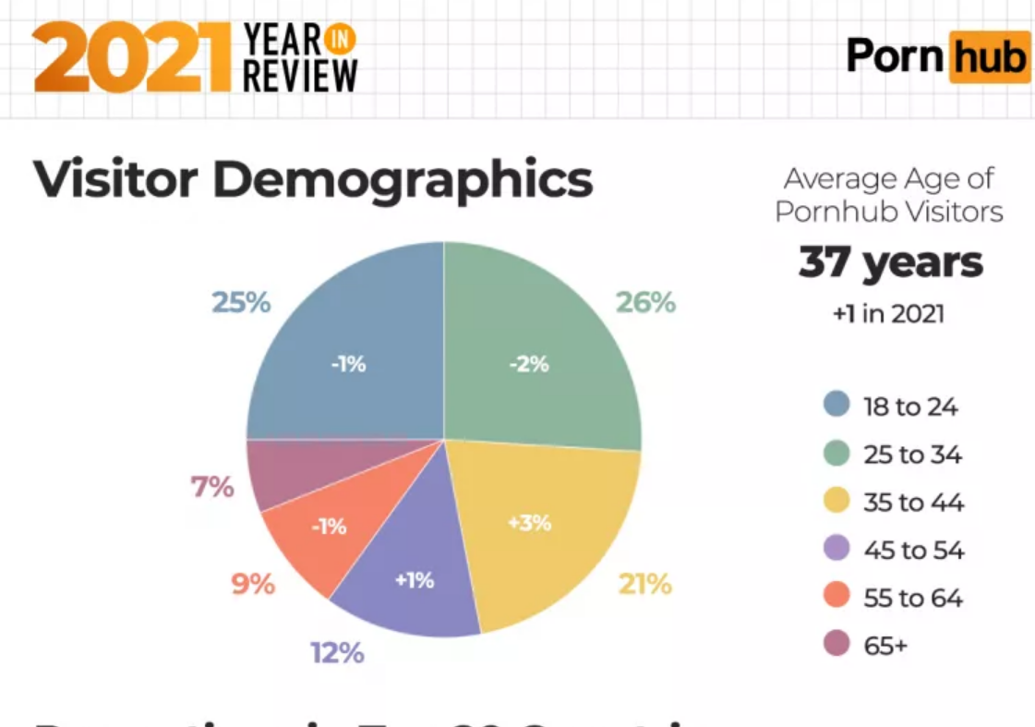
Multiple jobs; prefer satisfaction over duty and money
ADHD more prevalent
More mental illness: Depression and Anxiety
Challenge status quo
Cancel culture
Watch porn at work (Millennials too)

Slide 45
Generation Z: Challenges in the Workforce for
Public Safety

Slide 46
Generation Z: Challenges in the Workforce for
Public Safety
Areas of difficulty for law enforcement
Gen Z Characteristics
Following orders without questions
Prefer to collaborate in decision-making and feel entitled to understanding how or why decisions are made.
Seeks transparency (why are you telling me this? What’s in it for you?)
Notes:
Survey Article by Captain Angela “Angy” Scroble has been in law enforcement for 25 years with the Ocala Police Department.

Slide 47
Generation Z: Challenges in the Workforce for
Public Safety
Areas of difficulty for law enforcement
Gen Z Characteristics
Respect for higher ranking officers and following hierarchy
Prefers informality/flexibility and basic structure that allows for their own independence
Tends to respect those with contribution compared to tenure
Notes:
Survey Article by Captain Angela “Angy” Scroble has been in law enforcement for 25 years with the Ocala Police Department.

Slide 48
Generation Z: Challenges in the Workforce for
Public Safety
Areas of difficulty for law enforcement
Gen Z Characteristics
Taking one for the team
Prioritize their own desires and well-being and are willing to utilize sick or vacation time without understanding the repercussions on coworkers or agency
Quick to abandon an agency if they are no longer feeling fulfilled from the job
Notes:
Survey Article by Captain Angela “Angy” Scroble has been in law enforcement for 25 years with the Ocala Police Department.

Slide 49
Generation Z: Challenges in the Workforce for
Public Safety
Areas of difficulty for law enforcement
Gen Z Characteristics
Shift Work and Overtime
Desires flexibility in their schedule and are uninterested in a 40-hour work week
Notes:
Survey Article by Captain Angela “Angy” Scroble has been in law enforcement for 25 years with the Ocala Police Department.

Slide 50
Generation Z: Challenges in the Workforce for
Public Safety
Areas of difficulty for law enforcement
Gen Z Characteristics
Quality work
Have the tendency to multi-task while moving quickly towards completion, as they appreciate speed over efficiency
Notes:
Survey Article by Captain Angela “Angy” Scroble has been in law enforcement for 25 years with the Ocala Police Department.

Slide 51
Generation Z: Challenges in the Workforce for
Public Safety
Areas of difficulty for law enforcement
Gen Z Characteristics
Oral and written communication
Highly developed in visual learning and are used to digitally communicating
Notes:
Survey Article by Captain Angela “Angy” Scroble has been in law enforcement for 25 years with the Ocala Police Department.

Slide 52
Generation Z: Challenges in the Workforce for
Public Safety
Areas of difficulty for law enforcement
Gen Z Characteristics
Commitment
Prefer instant gratification (raises) compared to long-term projects, promotions and retirement
Short attention spans, leading to need for differing training modalities
Notes:
Survey Article by Captain Angela “Angy” Scroble has been in law enforcement for 25 years with the Ocala Police Department.

Slide 53
Generation Z: Challenges in the Workforce for
Public Safety
Areas of difficulty for law enforcement
Gen Z Characteristics
Experience
Thought to be coddled; live with parents, lack responsibility, have not encountered “struggles”
Notes:
Survey Article by Captain Angela “Angy” Scroble has been in law enforcement for 25 years with the Ocala Police Department.

Slide 54
Generation Characteristic vs Personality Traits
Personality Traits
In general, personality consists of the recurring patterns of thoughts, emotions, characteristics, and behaviors that make a person unique.
Arises from within each individual and remains fairly consistent and permanent throughout life.
Personality Traits can manifest into positive personality or personality disorder.
Notes:
When faced with generational characteristic, we can see how generations can be influenced by life cycle, cohorts, period effect, family, culture, economy one issue that can pertain to hiring employees can be distinguishing generational characteristic from personality traits

Slide 55
Personality Traits vs. Generational factors in the Workforce
Generational characteristic or personality trait?
  Sexting or accidentally sexting your mother
  Multiple jobs quitting and getting fired
  Poor written communication
  Asking for a promotion without completing established procedures
  Physically abusing animals
  Foul language towards superiors
Notes:
Go to Slido and find these traits. Lets look at them one at a time. I would like for this activity if you only select one or the other. Go with your gut. Take a look at these characteristics and choose either personality trait or generational factor.

Slide 56
Personality Traits vs. Generational Factors in the Workforce
  Destruction of property
  Stealing
  Watching porn at age 11,
  watching porn at work
  Open container while driving
  Smoking marijuana almost daily
  Mental illness
  Challenge superiors
Notes:
Could some of these be both? If you can view some of them as being related to both, congratulations you are knowledgeable and have an open mind. How can we determine between personality and generation. Like in the video about millennials, could any of those generational characteristics they showed be personality flaws. How could you find out? For the young man who did his research on google. Now that we are generation experts, we could have understood that he like many of his same age co-workers attention span is short and he has access to a lot of resources of information. If, prior to his deadline he was given the opportunity to use the information provided and any other resource to find the solution, its possible he would have provided an acceptable solution, but if he didn’t, do anything that is leaning towards a personality flaw (i.e. depression, substance abuse, antisocial, narcissistic etc.).

Slide 57
Activity #1: Identify Personality Traits
Refer to handout: Positive, Negative and Even Personality Traits
Identify as many positive traits as you can
Identify as many negative traits as you can
Identify as many even traits as you can
Notes:
Go to Slido and start filling in positive personality traits. Then negative traits and even traits.

Slide 58
Public safety personality traits
Positive Personality Traits for Public Safety
Negative Personality Traits for Public Safety
Compare with Generation Z Characteristics
Tools for comparing Generation Z with personality traits

Slide 59
Positive Public Safety Personality Traits
Agreeableness
Assertiveness/Extroversion
Conscientiousness/Responsibility/ Dependability
Emotional toughness (freedom from anxiety, hostility and psychological distress)
Flexibility/Adaptability
Independence/Achievement orientation
Social confidence/Self-assuredness
Social sensitivity Tolerance
Well-being
Integrity
Intellectual efficiency
Self-discipline/Self-control
Social confidence/Self-assuredness
Social sensitivity Tolerance
Well-being

Slide 60
Negative Public Safety Personality Traits
Aggressiveness
Argumentativeness
antagonism
Antisocial tendencies
Disregard for societal rules
and laws
Egocentricity
Emotional instability/anxiety
Hostility Immaturity
Impulsiveness
Irresponsibility/unreliability
Overconfidence,
Paranoia Pessimism,
Poor decision-making
Proneness to alcohol abuse
Rebelliousness
Social introversion,
Suspiciousness,
cynicism and distrustfulness
Insensitivity or oversensitivity,
Intolerance,
Lack of empathy

Slide 61
Differentiating Gen Z from Public Safety Personality Traits
Aversion to homeownership
Positive | Negative
Adaptable | Irresponsible
Independent | Immature
Intellectually Efficient | Poor decision making
Not married or not dating
Self-discipline | Lack of empathy
Independent | Emotionally unstable
Self-control | Hostility
Push the envelope in the workplace
Intellectual efficiency | Egocentric
Social Confidence | Impulsive
Assertiveness | Rebellious

Slide 62
Activity #2
Here are some other Gen Z characteristics. Identify any generational characteristic, positive and negative personality traits. Refer to handout.
Demand flexibility, equality and transparency from their organization.
Gen Characteristic = insubordination
Positive = ?
Negative = ?
Multiple jobs up to 20 in a lifetime, changing careers up to 12 times.
Gen Characteristics = ?
Positive = Achievement Oriented, Self- assured
Negative = ?
Notes:
Refer to your handout for public safety traits. Please enter your selection for #1 Positive and then Negative personality traits and then #2 Gen Characteristic and negative personality trait (use general list or public safety list or both.)

Slide 63
Tools for Differentiating: Background Investigators
1. Be aware of generational characteristics and bias
2. Know the differences between positive and negative personality traits.
3. Be curious, ask more questions. Find the positive and negative traits.
Why don’t you own a home?
Never thought about it, not worth it these days = (irresponsible, egocentric, poor decision making, pessimism).
It doesn’t make sense to go so far into debt when I haven’t confidently secured finances. The house prices are too high and the economy is too unpredictable = (responsibility, adaptability, intellectual efficiency).

Slide 64
Tools for Differentiating: Background Investigators
Why did you get written up by your supervisor?
It really wasn’t my fault = (rebellion, anti-social, disregard for social rules).
I thought I found a better way, I was trying to be productive = (Self-assured,
achievement oriented)
4. Ask for examples of demonstrated behavior to back up claim.
Having a good savings account, evidence of productivity at current or past jobs, evidence of effectiveness, achievements. Or, no savings, multiple jobs with no
accommodations
5. Look for corroborating information to confirm positive and negative findings i.e., stated, demonstrated, reported by others, observed etc.

Slide 65
In Conclusion
Eight billion google search results: Generations Z in the workplace
360,000 scholarly articles: Generation Z in the workplace
No differences in work ethic?
  No difference in how work is a central part of life.
  No difference in how they relate their effort to success in the workplace
Only a small difference across generations regarding attitudes
No difference in organizational commitment
No difference in job dissatisfaction
No difference in commitment or intent to stay

Slide 66

In Conclusion
No difference in age group and job attitude
No difference on the 35 different job attitudes
No difference in older generations attitude towards pay and hours
Generational characteristics: May or may not be a factor
Don’t make assumptions
Look at the personality traits and corroborating information

Slide 67

Post-Test
If you have access to Slido please go to the post-test and answer the questions. If you don’t have Slido ability, please complete the post-test in your handout.
Notes:
Slido Quiz

